Slide 1
Expression Evaluation

Slide 2
Algorithm for Infix to Postfix
1) Examine the next element in the input.
2) If it is operand, output it.
3) If it is opening parenthesis, push it on stack.
4) If it is an operator, then
  i) If stack is empty, push operator on stack.
  ii) If the top of stack is opening parenthesis, push operator on stack
  iii) If it has higher priority than the top of stack, push operator on stack.
  iv) Else pop the operator from the stack and output it, repeat step 4
5) If it is a closing parenthesis, pop operators from stack and output them until an opening parenthesis is encountered. pop and discard the opening parenthesis.
6) If there is more input go to step 1
7) If there is no more input, pop the remaining operators to output.

Slide 3
Precedence
Symbol Off Stack On Stack
Precedence Precedence
+ 1 1
- 1 1
* 2 2
/ 2 2
^ 10 9
( 20 0

Slide 4

Infix to postfix conversion
infixVect
( a + b - c ) * d – ( e + f )
postfixVect

Slide 5
Infix to postfix conversion
stackVect
infixVect
a + b - c ) * d – ( e + f )
postfixVect
(

Slide 6
Infix to postfix conversion
stackVect
infixVect
+ b - c ) * d – ( e + f )
postfixVect
a
(

Slide 7
Infix to postfix conversion
stackVect
infixVect
b - c ) * d – ( e + f )
postfixVect
a
+
(

Slide 8
Infix to postfix conversion
stackVect
infixVect
- c ) * d – ( e + f )
postfixVect
a b
+
(

Slide 9
Infix to postfix conversion
stackVect
infixVect
c ) * d – ( e + f )
postfixVect
a b +
-
(

Slide 10
Infix to postfix conversion
stackVect
infixVect
) * d – ( e + f )
postfixVect
a b + c
-
(

Slide 11
Infix to postfix conversion
stackVect
infixVect
* d – ( e + f )
postfixVect
a b + c -

Slide 12
Infix to postfix conversion
stackVect
infixVect
d – ( e + f )
postfixVect
a b + c -
*

Slide 13
Infix to postfix conversion
stackVect
infixVect
– ( e + f )
postfixVect
a b + c - d
*

Slide 14
Infix to postfix conversion
stackVect
infixVect
( e + f )
postfixVect
a b + c – d *
-

Slide 15
Infix to postfix conversion
stackVect
infixVect
e + f )
postfixVect
a b + c – d *
(
-

Slide 16
Infix to postfix conversion
stackVect
infixVect
+ f )
postfixVect
a b + c – d * e
(
-

Slide 17
Infix to postfix conversion
stackVect
infixVect
f )
postfixVect
a b + c – d * e
+
(
-

Slide 18
Infix to postfix conversion
stackVect
infixVect
)
postfixVect
a b + c – d * e f
+
(
-

Slide 19
Infix to postfix conversion
stackVect
infixVect
postfixVect
a b + c – d * e f +
-

Slide 20
Infix to postfix conversion
stackVect
infixVect
postfixVect
a b + c – d * e f + -

Slide 21
Suppose we want to convert 2*3/(2-1)+5*3 into Postfix form,
Expression | Stack | Output
2 | Empty | 2
* | * | 2
3 | * | 23
/ | / | 23*
( | /( | 23*
2 | /( | 23*2
- | /(- | 23*2
1 | /(- | 23*21
) | / | 23*21-
+ | + | 23*21-/
5 | + | 23*21-/5
* | +* | 23*21-/53
3 | +* | 23*21-/53
 | Empty | 23*21-/53*+
So, the Postfix Expression is 23*21-/53*+

Slide 22
Assignment
Show the algorithm in action for
  1 - 2 ^ 3 ^ 3 - ( 4 + 5 * 6 ) * 7
  2 ^ 3 ^ 3 + 5 * 1
  11 + 2 - 1 * 3 / 3 + 2 ^ 2 / 3

Slide 23
Evaluation of Postfix Expressions
Easy to do with a stack
given a proper postfix expression:
  get the next token
  if it is an operand push it onto the stack
  else if it is an operator
    pop the stack for the right hand operand
    pop the stack for the left hand operand
    apply the operator to the two operands
    push the result onto the stack
  when the expression has been exhausted the result is the top (and only element) of the stack

Slide 24
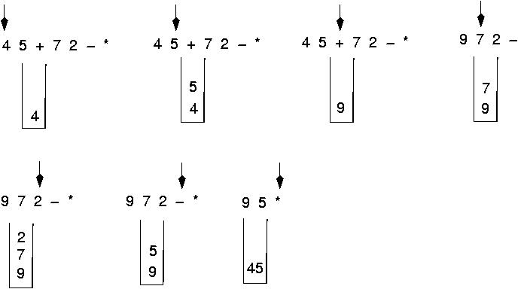
Postfix expressions:
Algorithm using stacks (cont.)

